Slide 1

Better Cater
Presented By:- Davinder Verma
Student Id:- 121802201

Slide 2



Slide 3
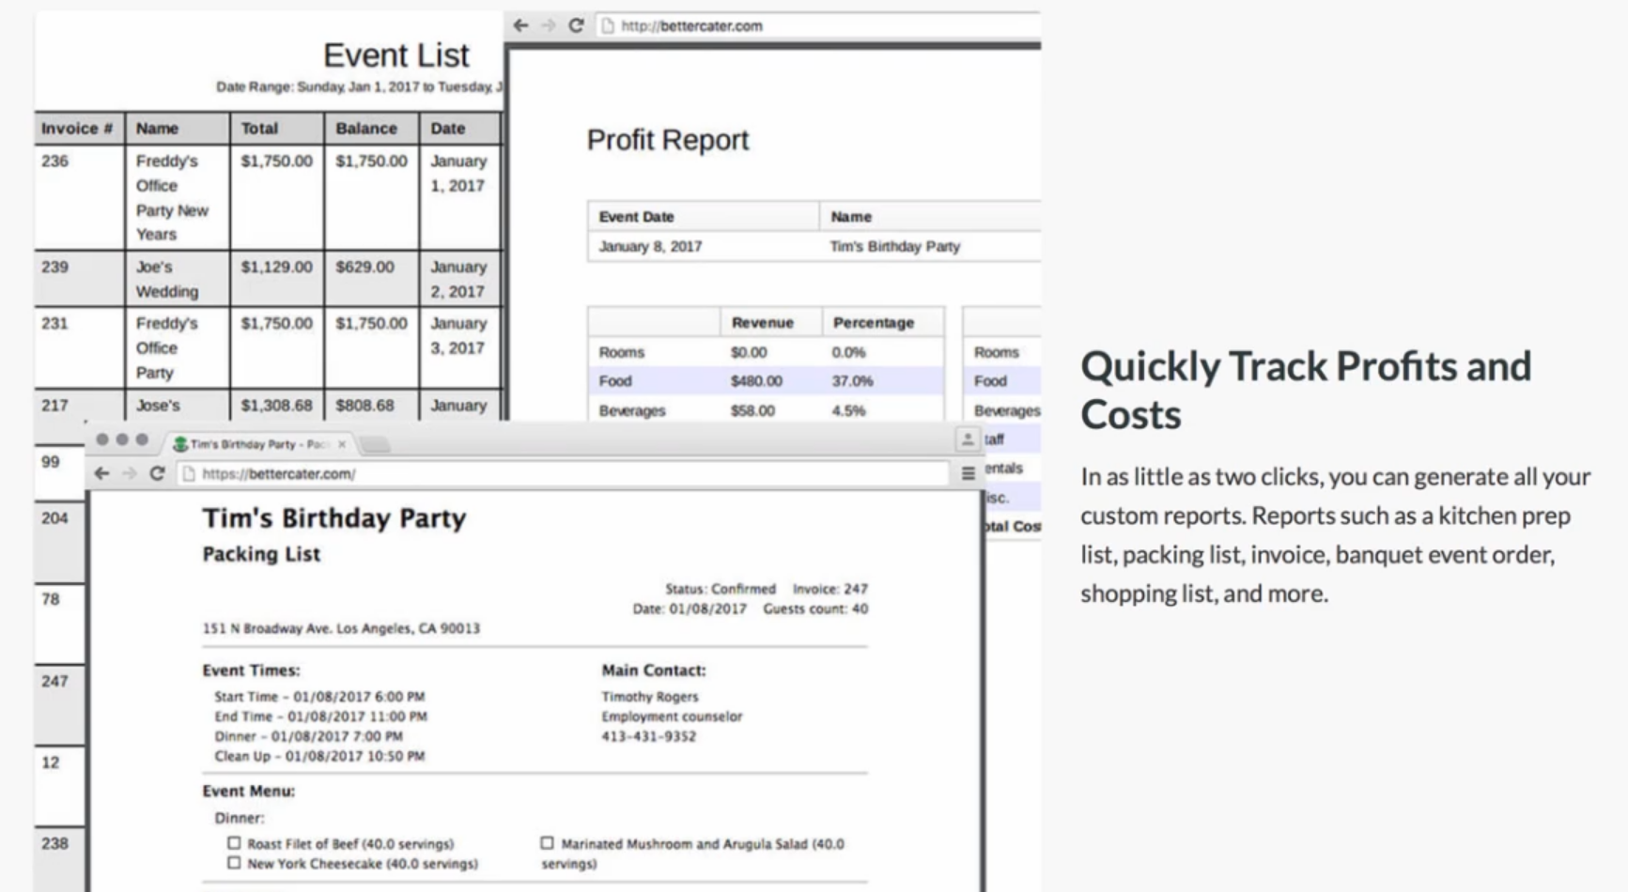

Slide 4
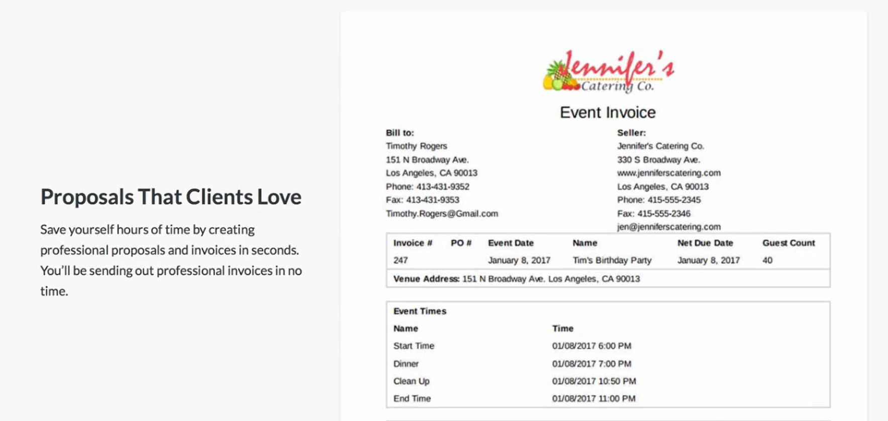

Slide 5
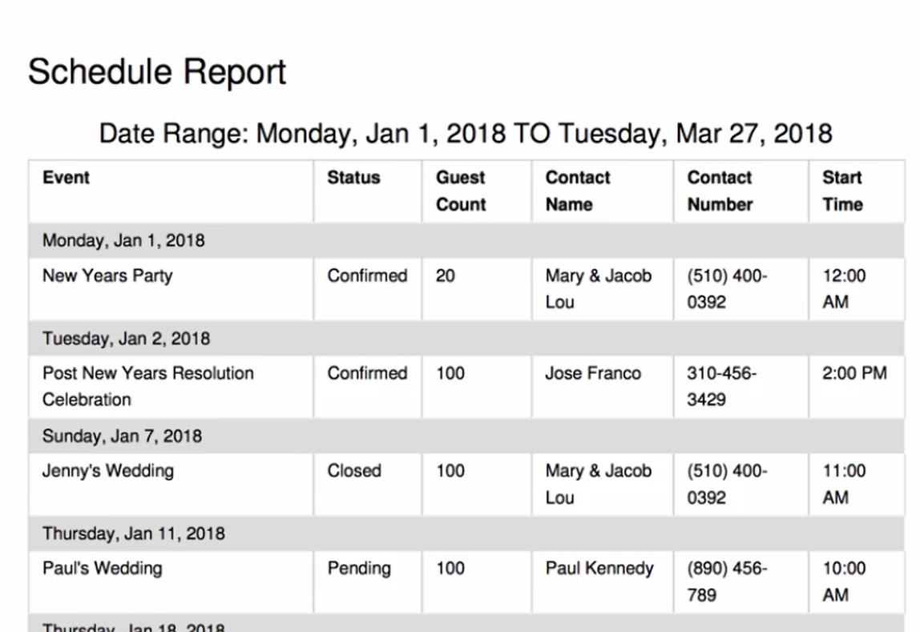

Slide 6
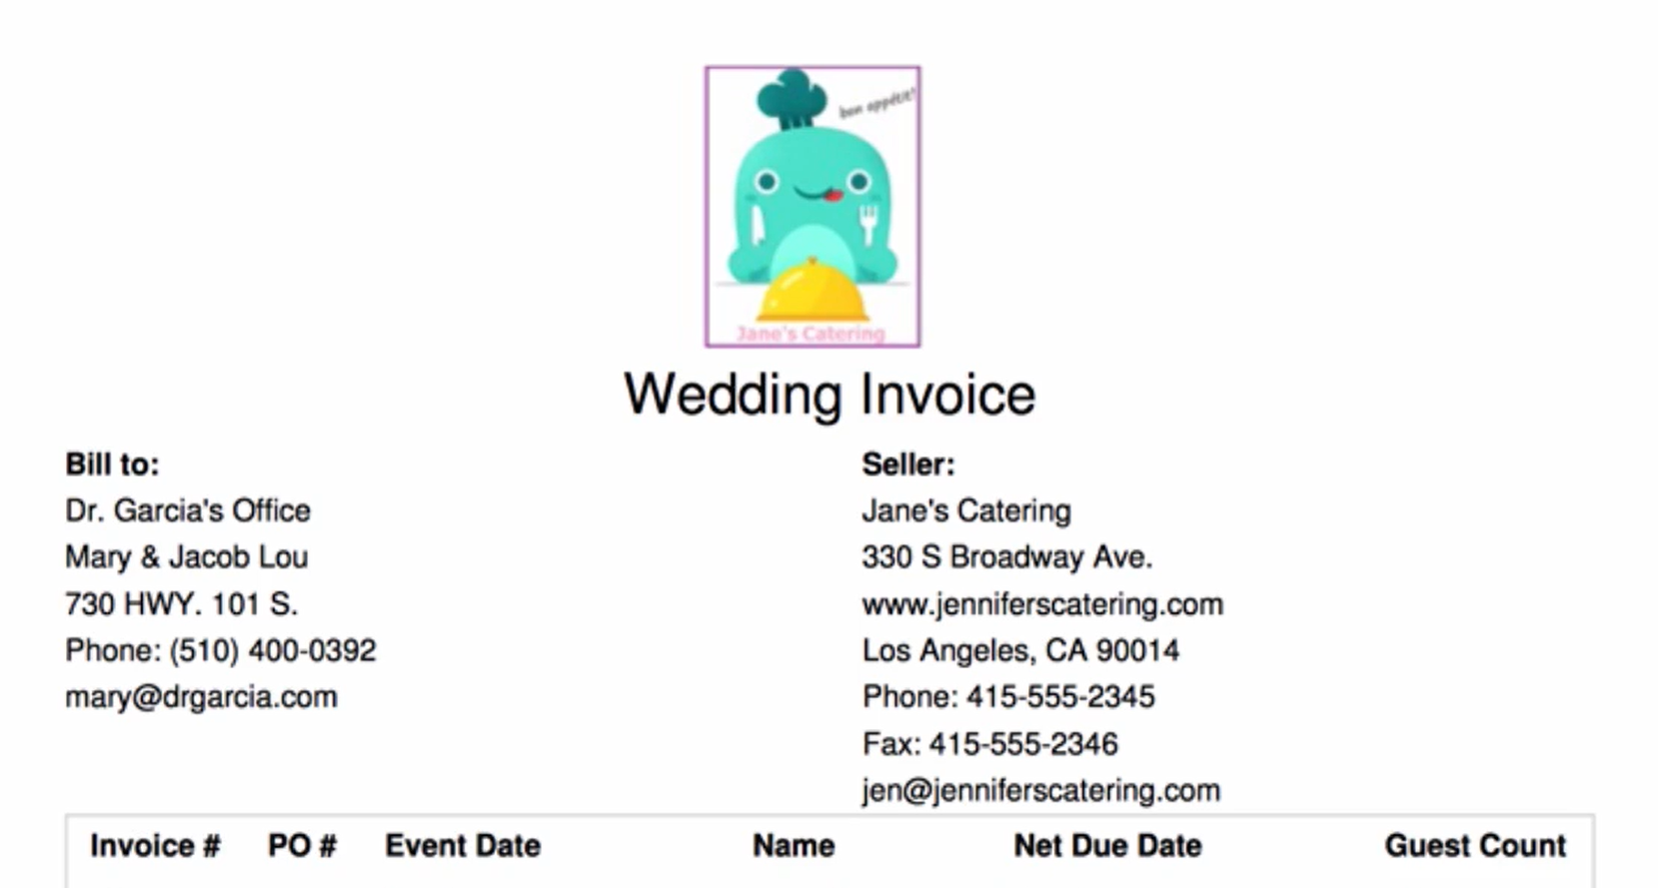

Slide 7
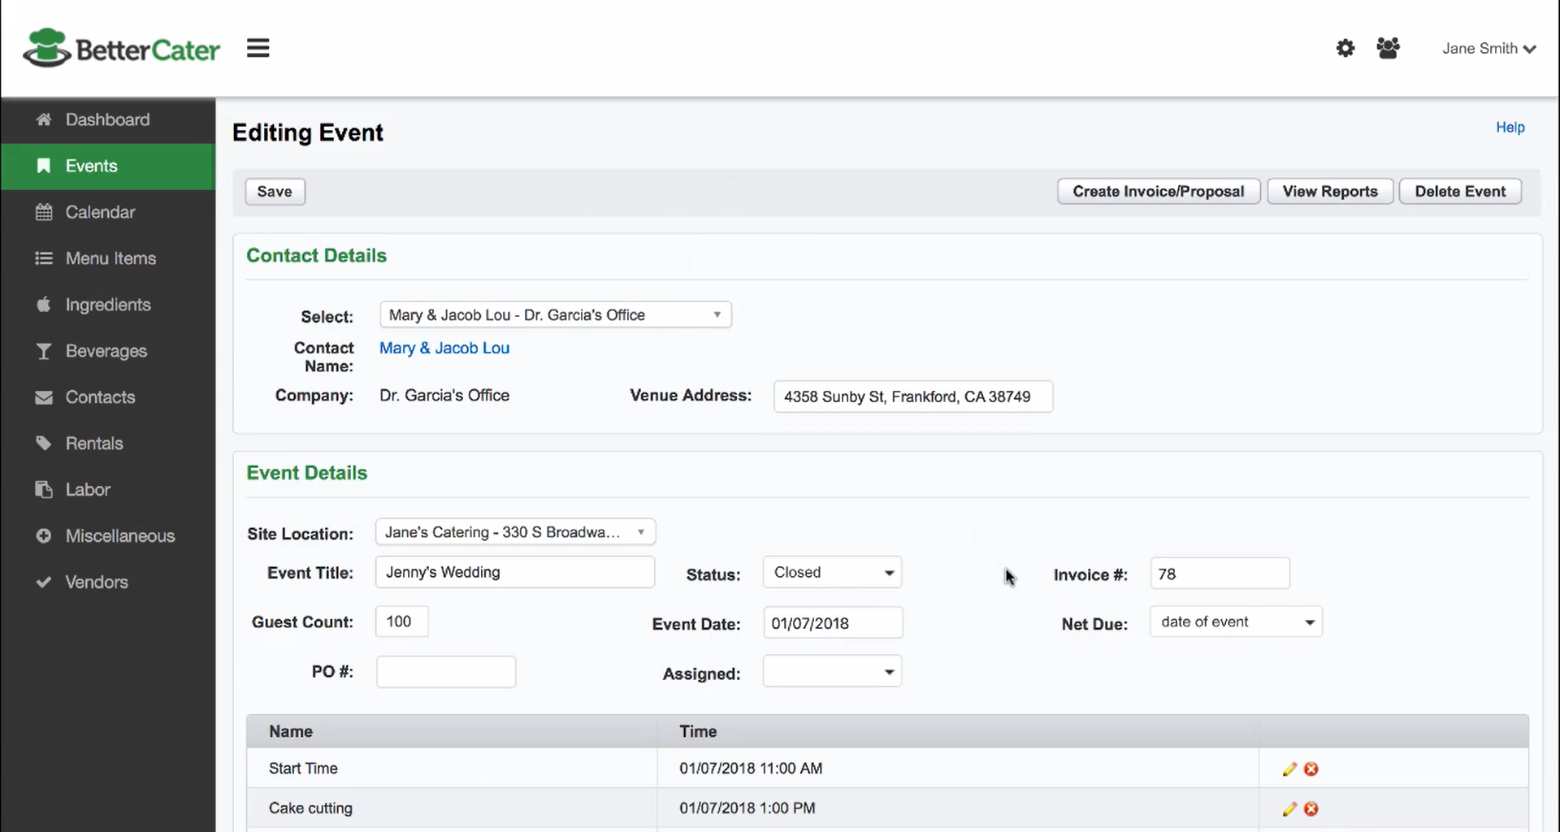

Slide 8
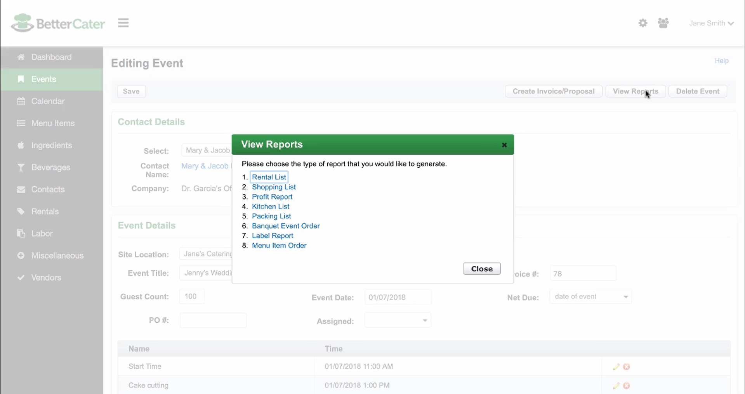

Slide 9
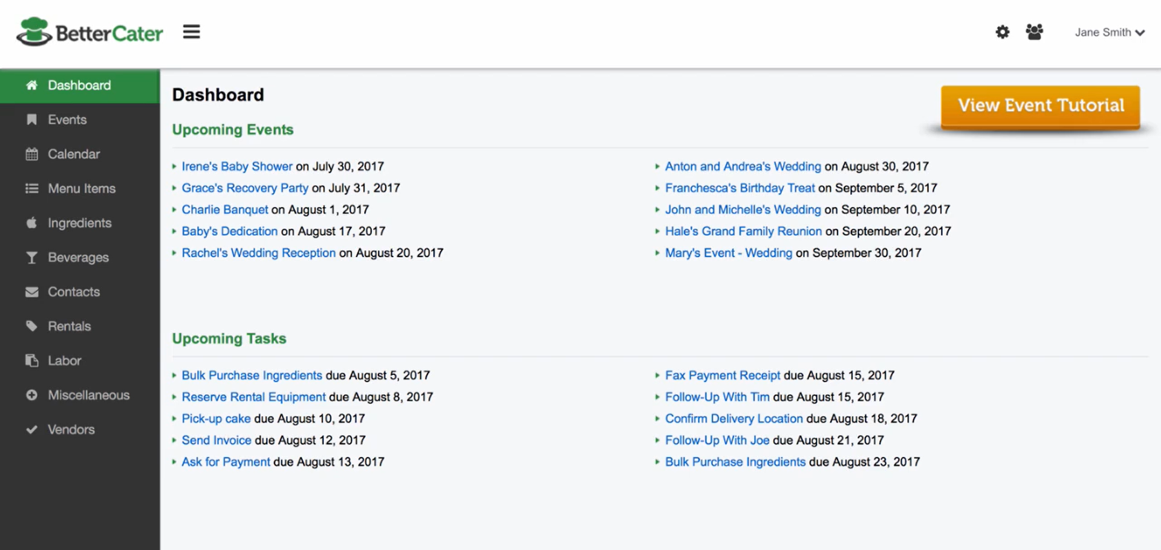

Slide 10
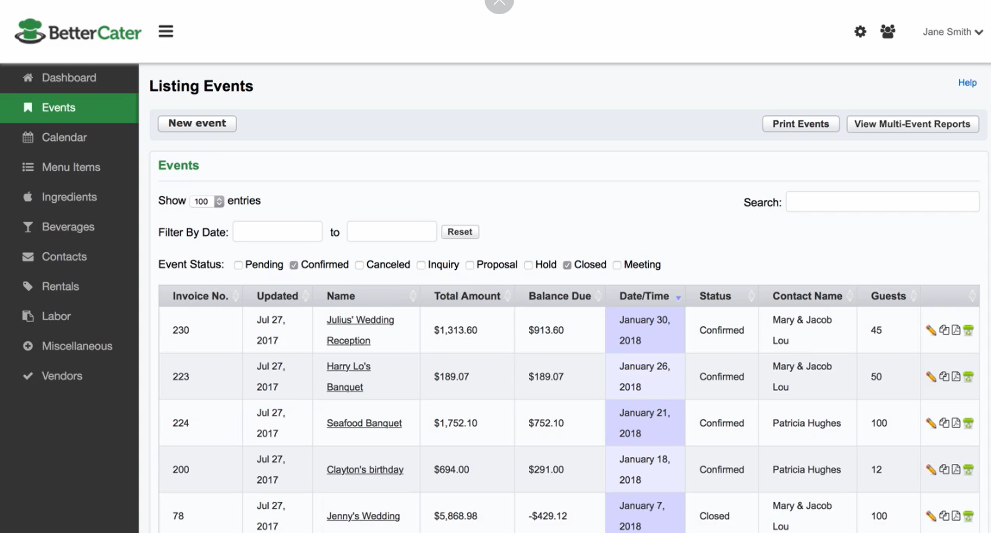

Slide 11
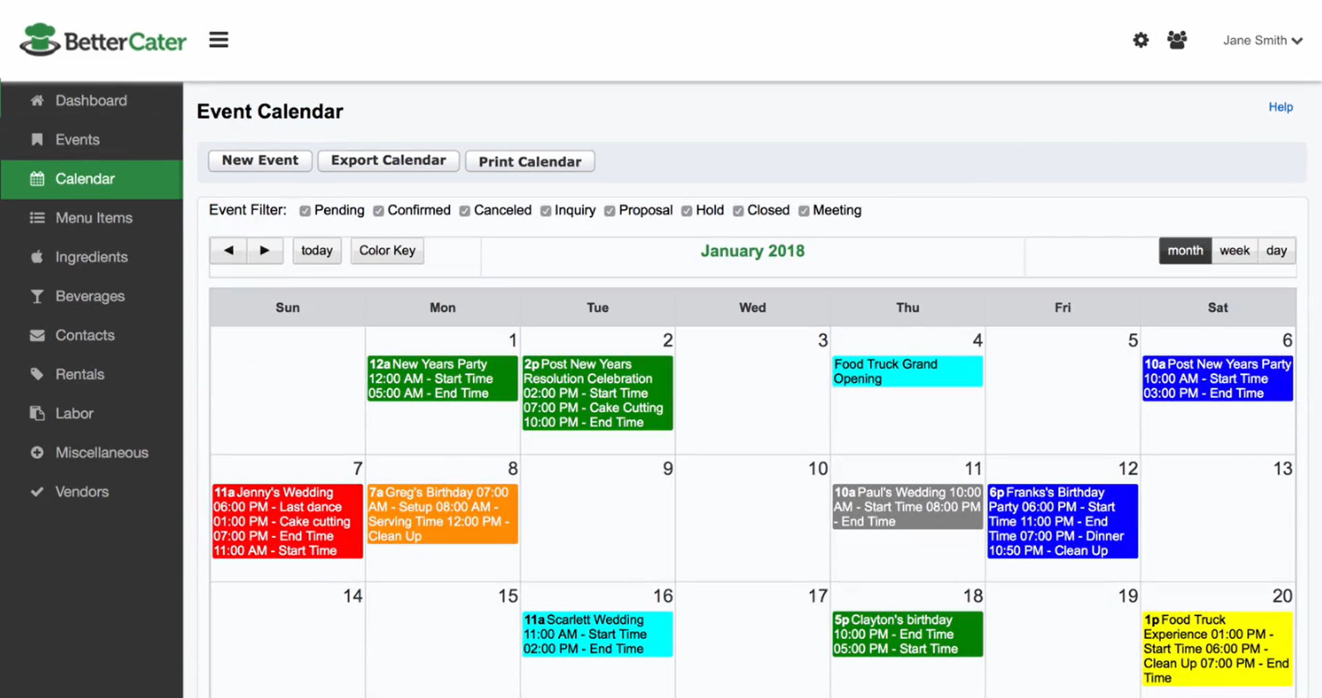

Slide 12
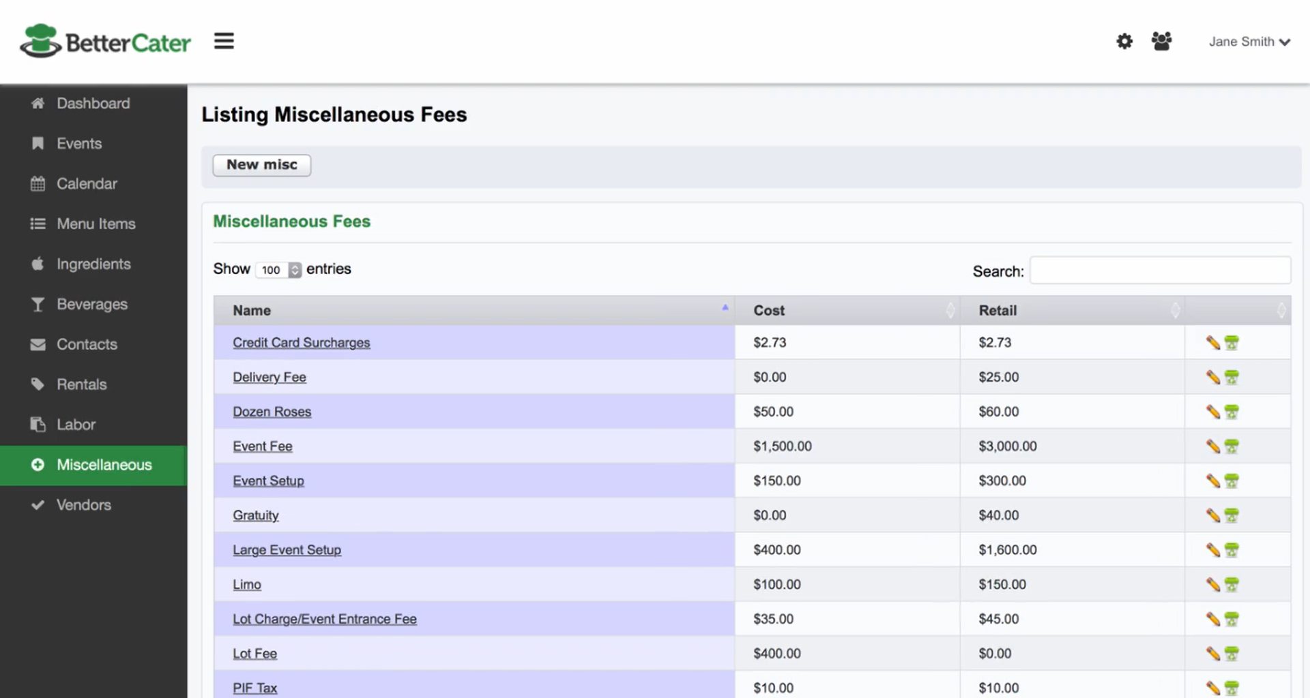

Slide 13
criteria | No | With some modifications | Yes
Record purchases of ingredients
Categorize ingredients by ingredient type
Build recipes and record calorie counts
Record sales of recipes
Schedule food delivery appointments
Is the software affordable?
What operating system will this run under? | It’s a cloud based, so works on every machine which can run a browser.
Hardware requirements or devices required | It can run on any device which has a browser.

Slide 14

Thanks For Watching

